Slide 1
Comparison of Clustering Methods on BL2 Data
Eli Carter

Slide 2
DBSCAN:
Parameters: Epsilon – max distance between two points to be ”neighbors”, min_samples – min # of points to be considered a cluster.
Pos/Neg: Uses density to cluster, can find oddly shaped clusters/not great with varying density

Slide 3
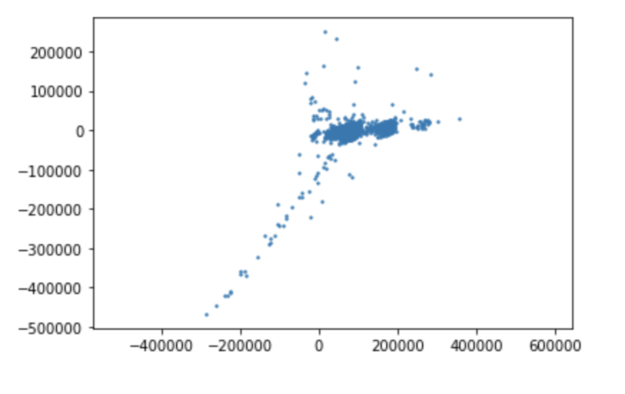
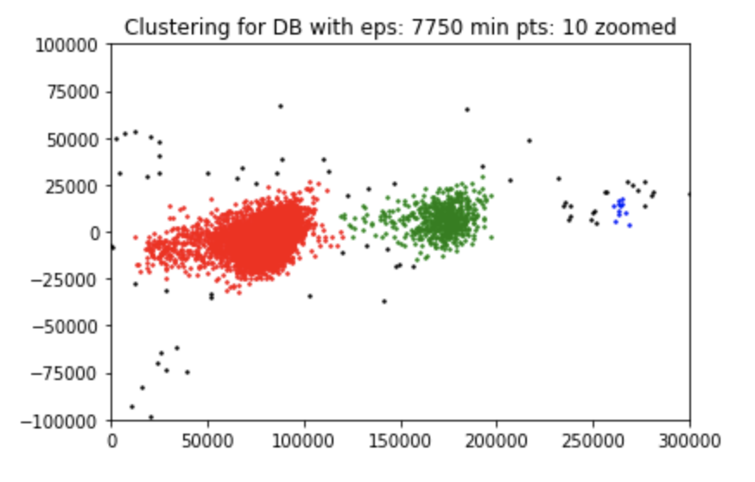
Clusters

Slide 4
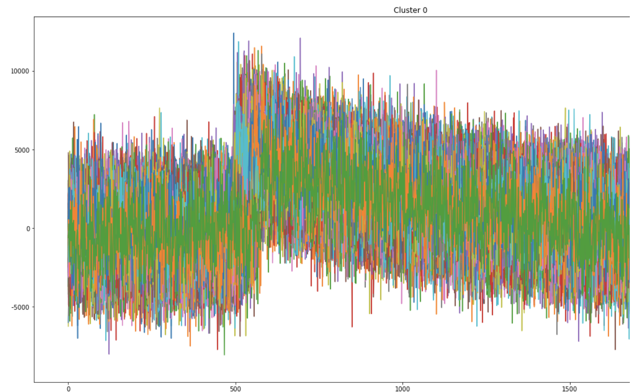
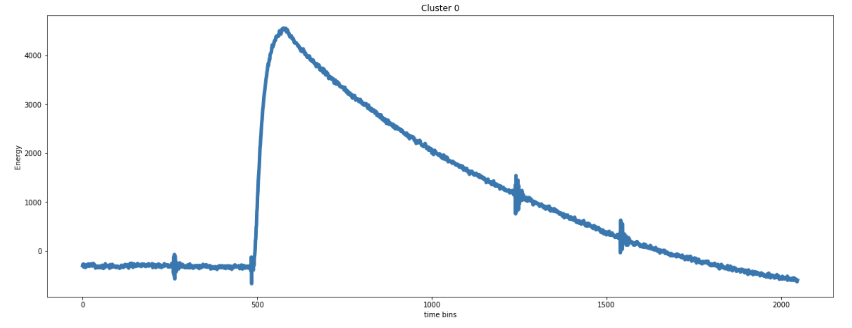
Characteristic Waveforms: Red (Singles)
Singles out of first 500 waveforms
Average

Slide 5
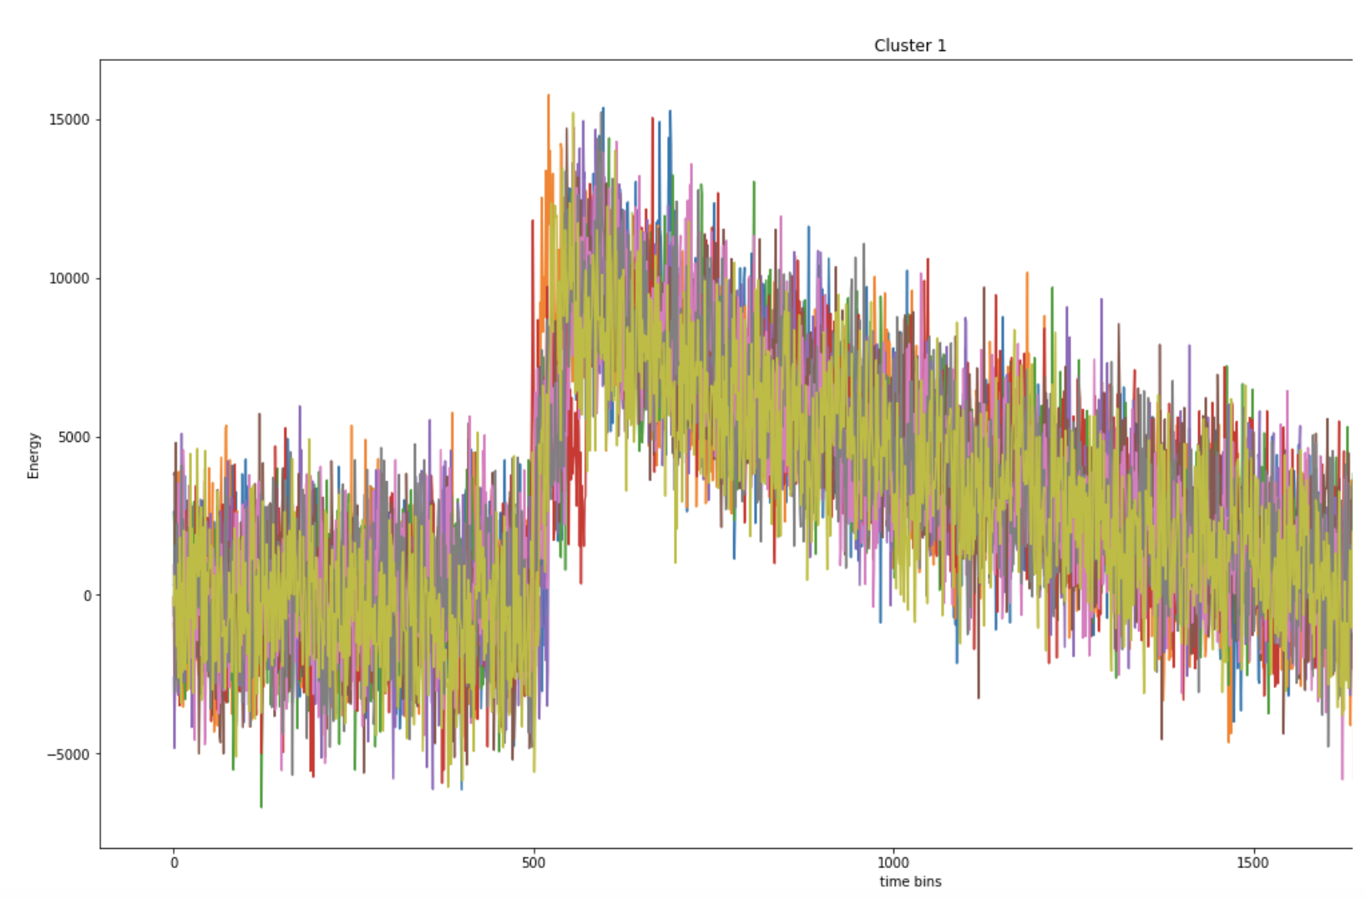
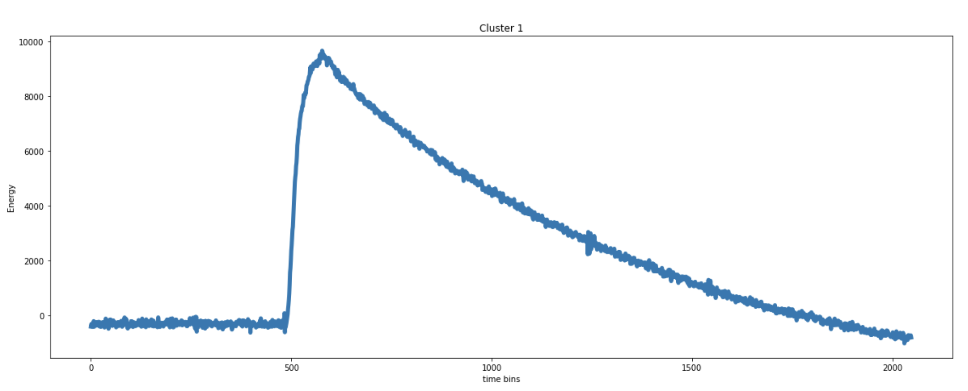
Characteristic Waveforms: Green (Doubles)
Doubles out of first 500 waveforms
Average

Slide 6
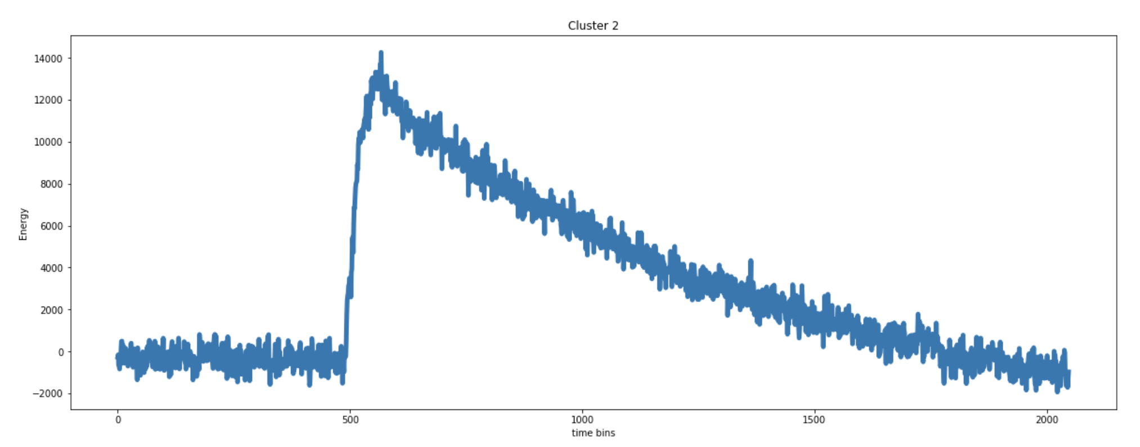
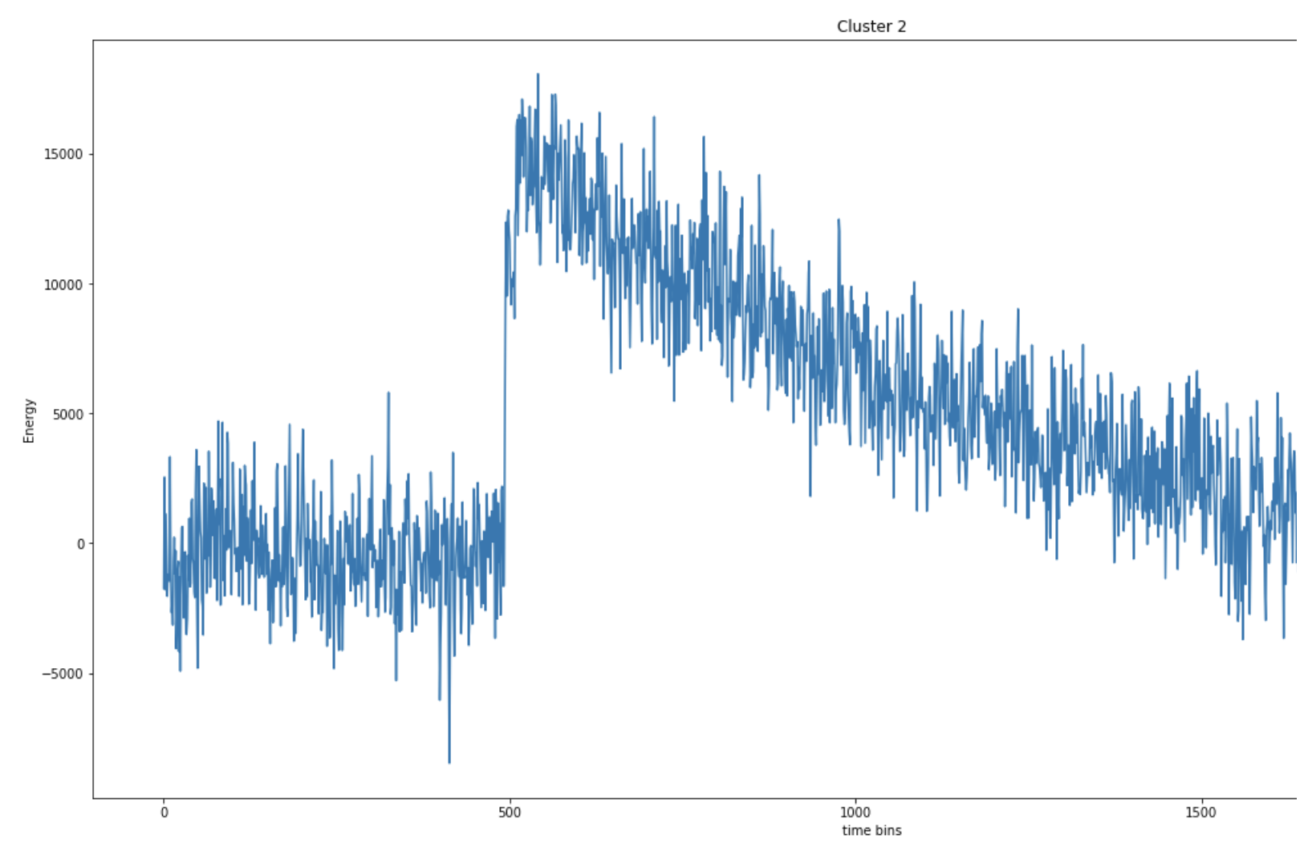
Characteristic Waveforms: Blue (Triples)
Triples out of first 500 waveforms
Average

Slide 7
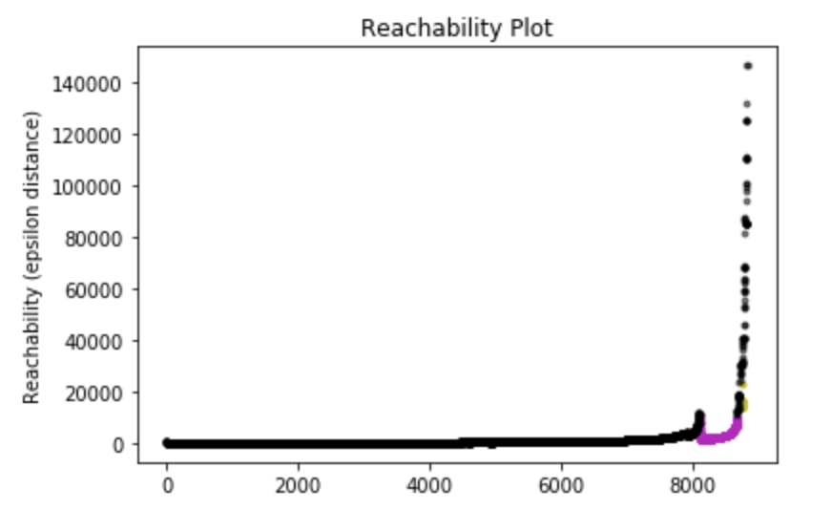
OPTICS: Xi
Hidden clusters where arrows are
Creates reachability plot of each point and clusters based on steepness on plot and on min num of points.
Pos/Neg: Finds varying density clusters/very sensitive to change in xi parameter and hard to use for BL2 dataset. Too many clusters

Slide 8
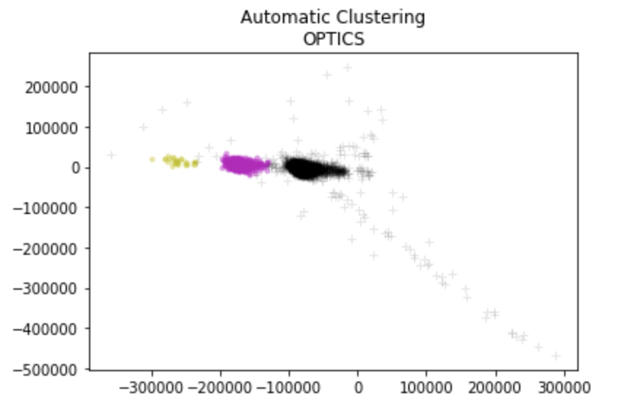
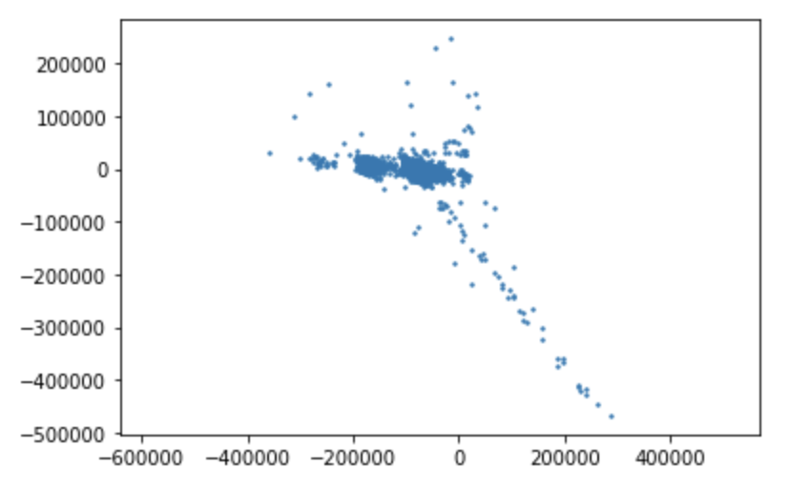
Clusters

Slide 9
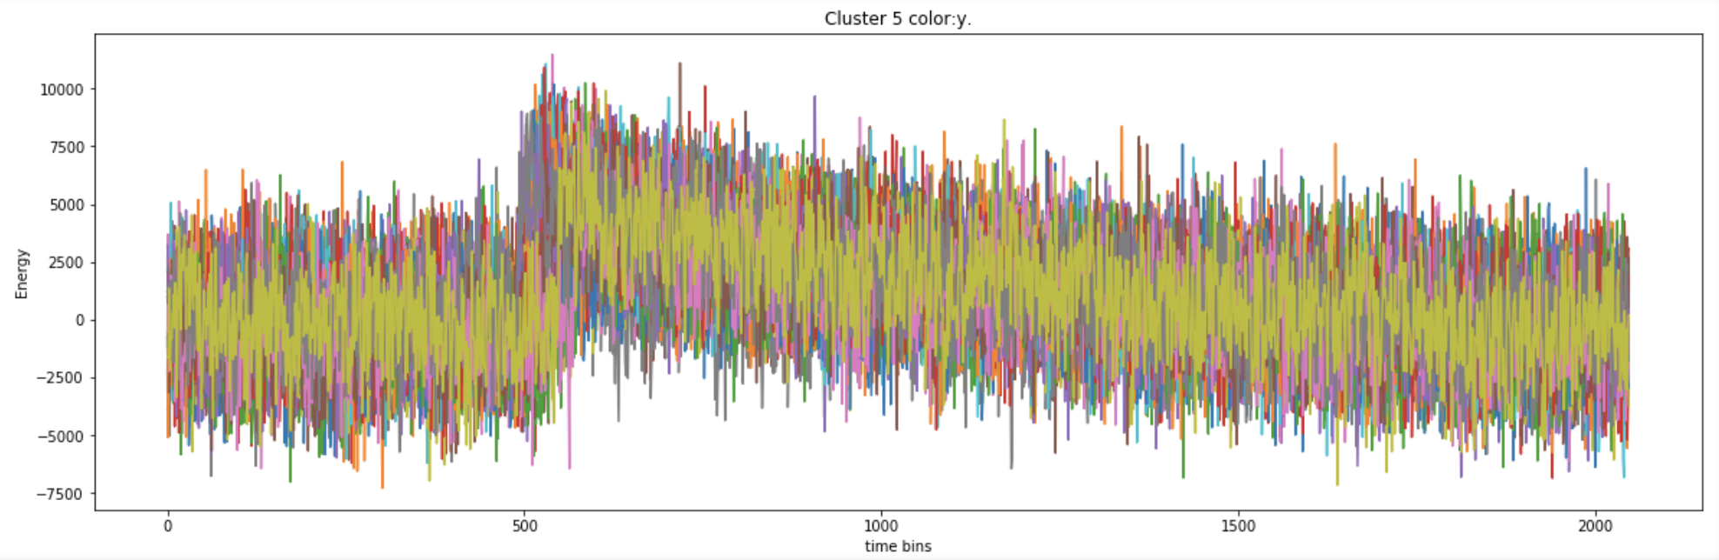
Characteristic Waveforms: Yellow

Slide 10
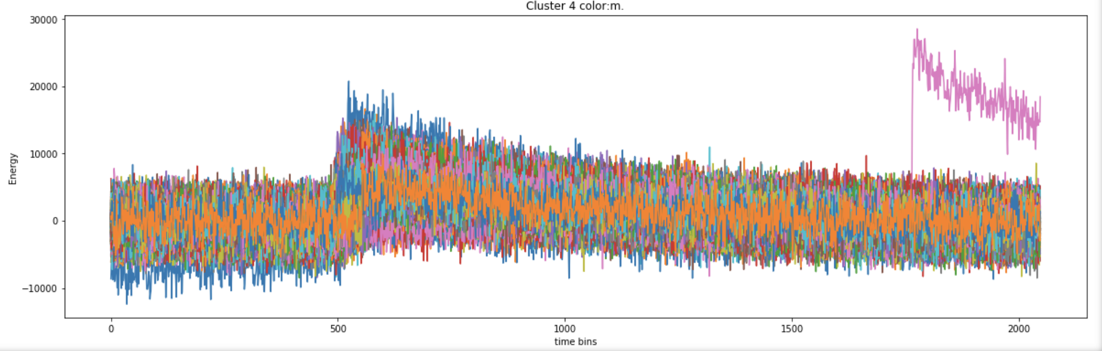
Characteristic Waveforms: Magenta

Slide 11
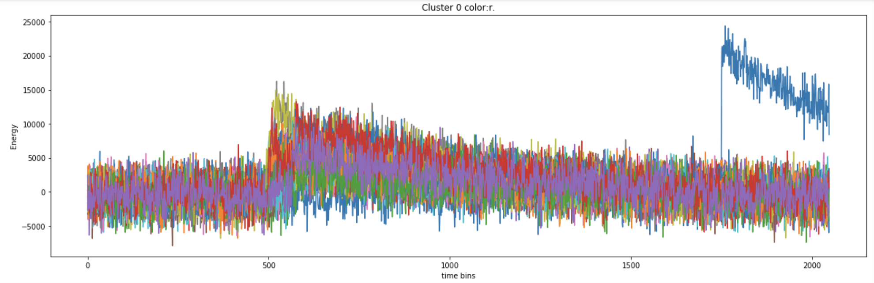
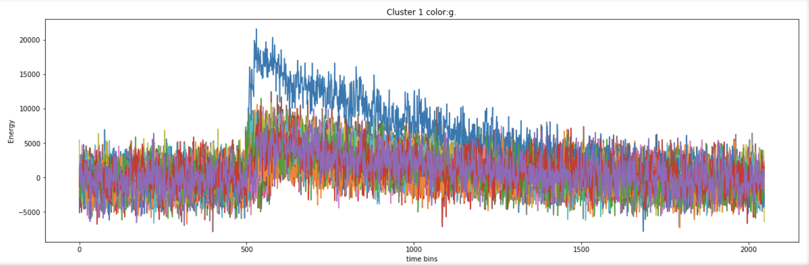
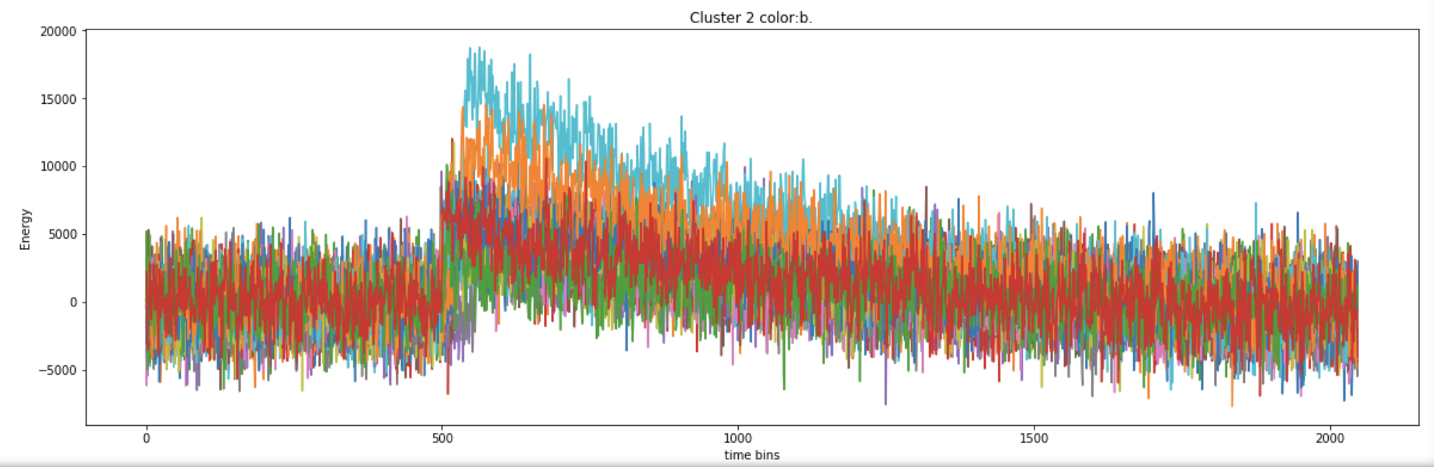
Characteristic Waveforms: Others…

Slide 12
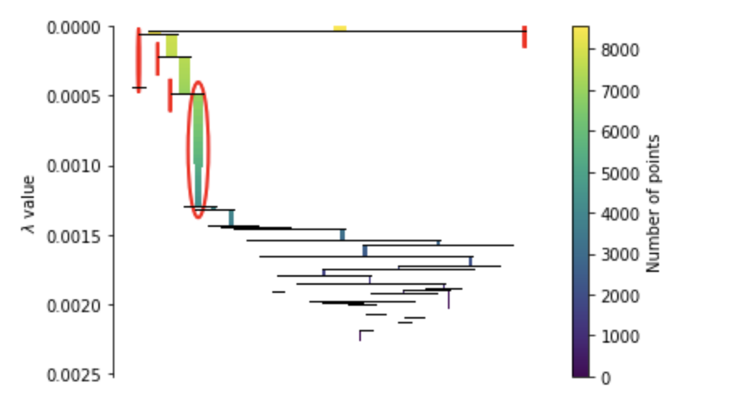
HDBSCAN
Similar to DBSCAN but uses spanning trees and graph theory to create a condensed tree plot, then uses the only parameter, min num of points, to decide on clusters.
Pos/Neg: Finds varying density clusters/No negatives yet (complexity close to n^2)

Slide 13
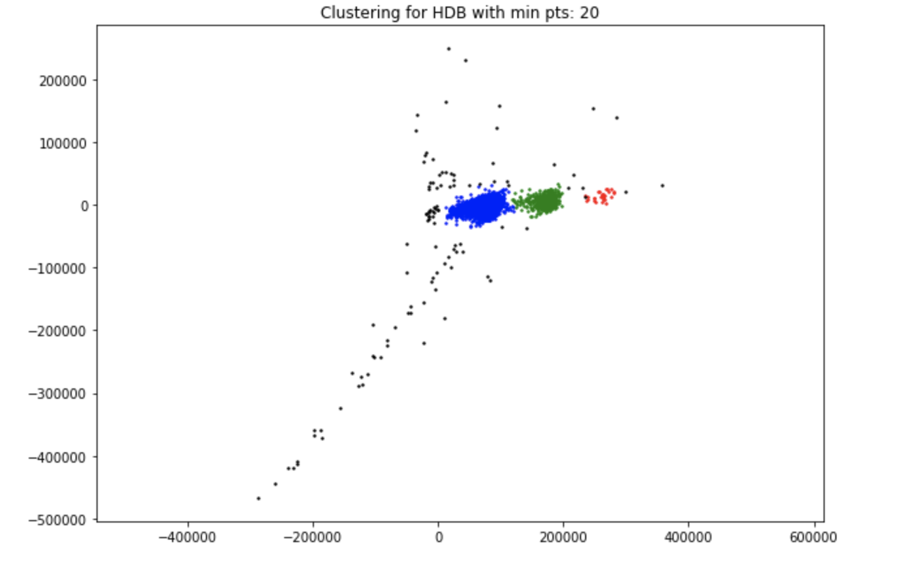
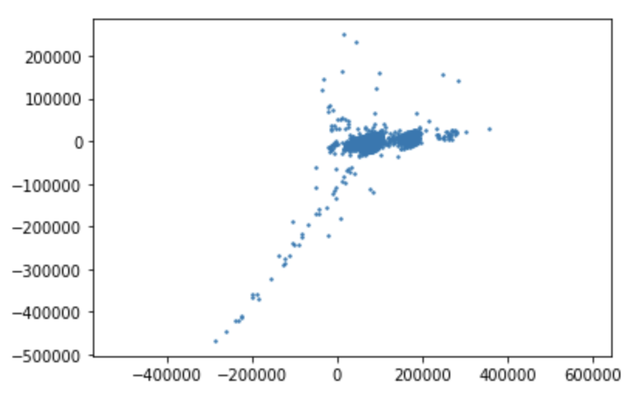
Clusters

Slide 14
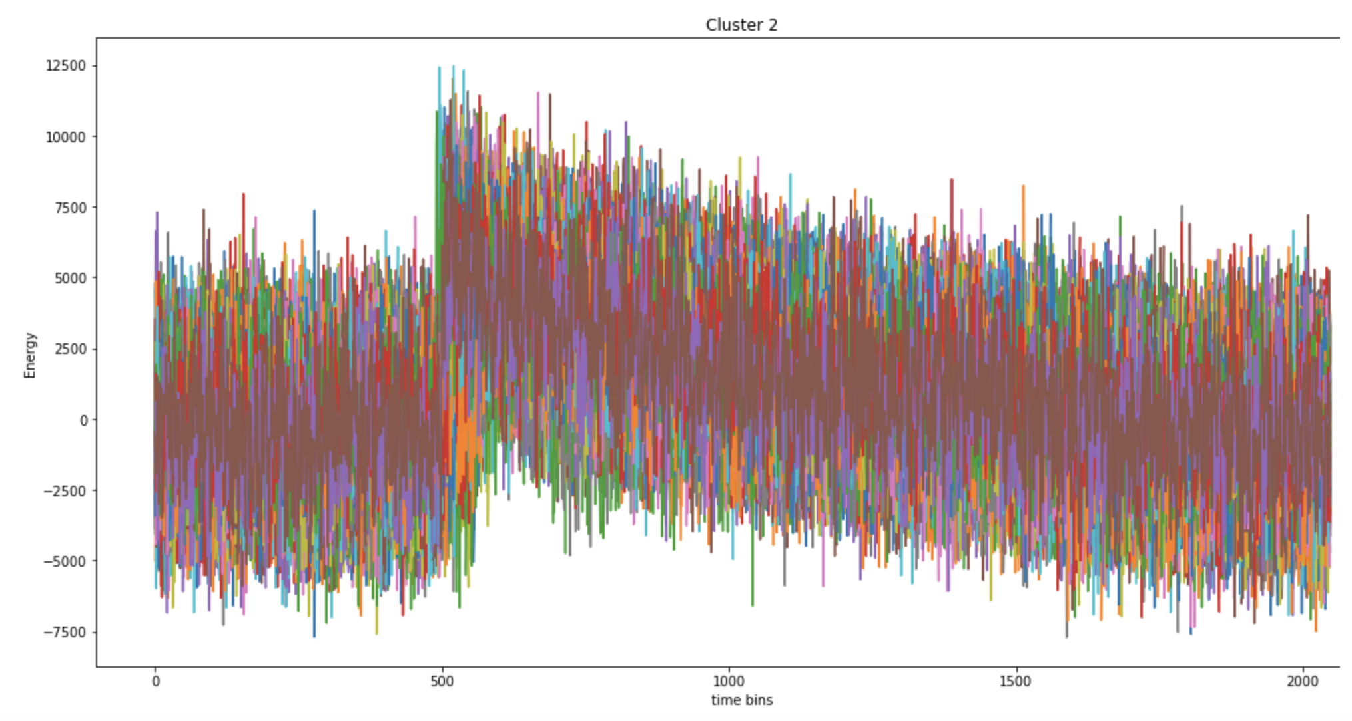
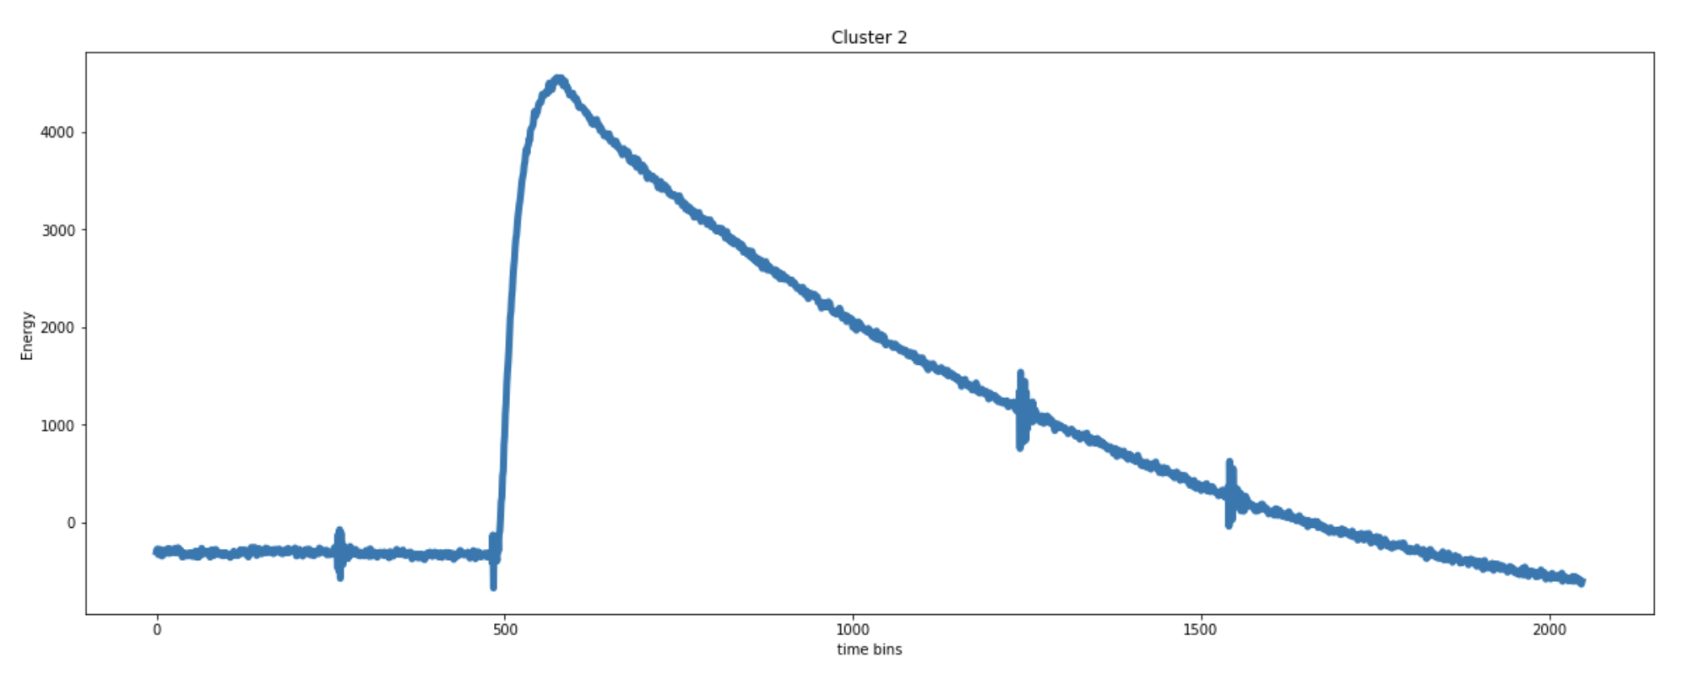
Characteristic Waveforms: Blue (Singles)
Singles out of first 500 waveforms
Average

Slide 15
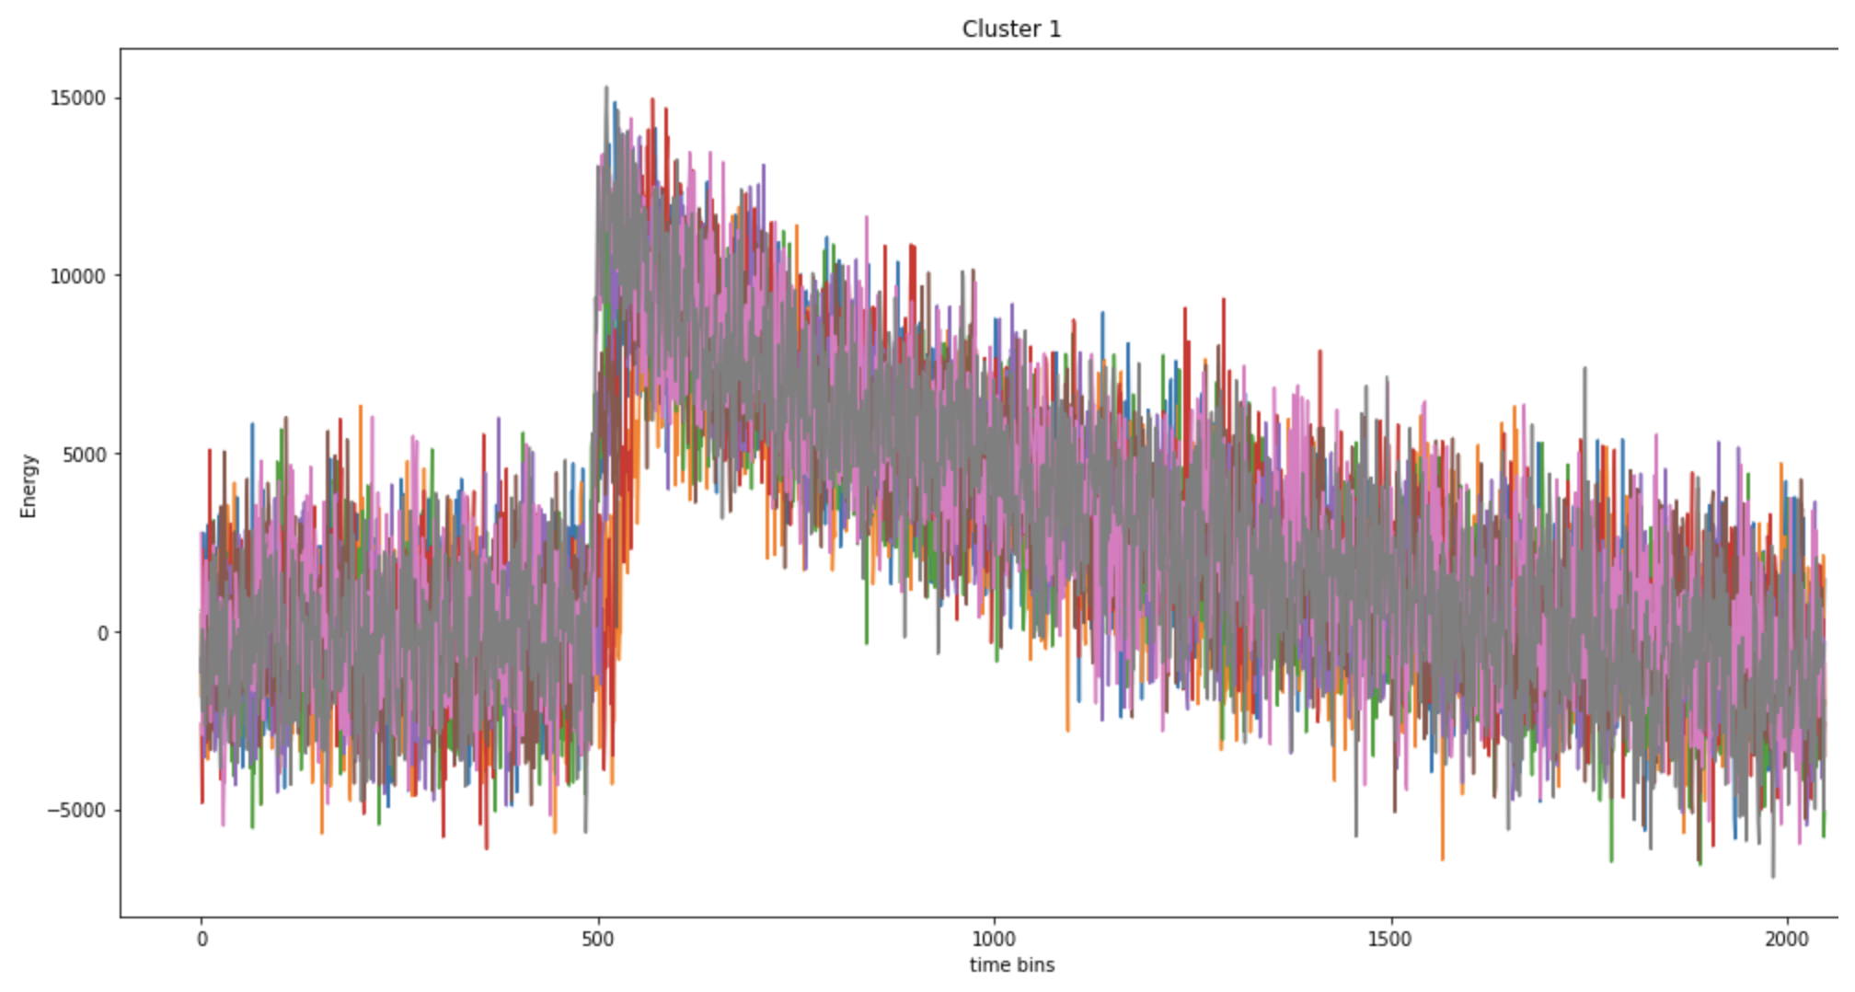
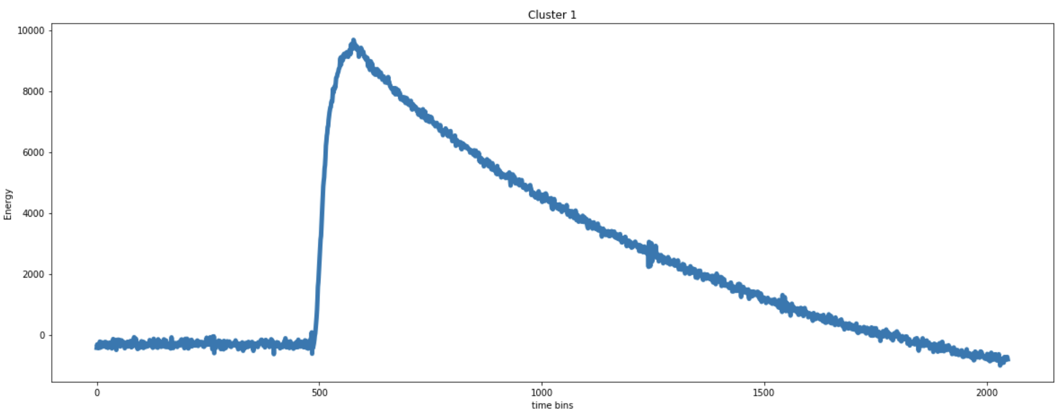
Characteristic Waveforms: Green (Doubles)
Doubles out of first 500 waveforms
Average

Slide 16
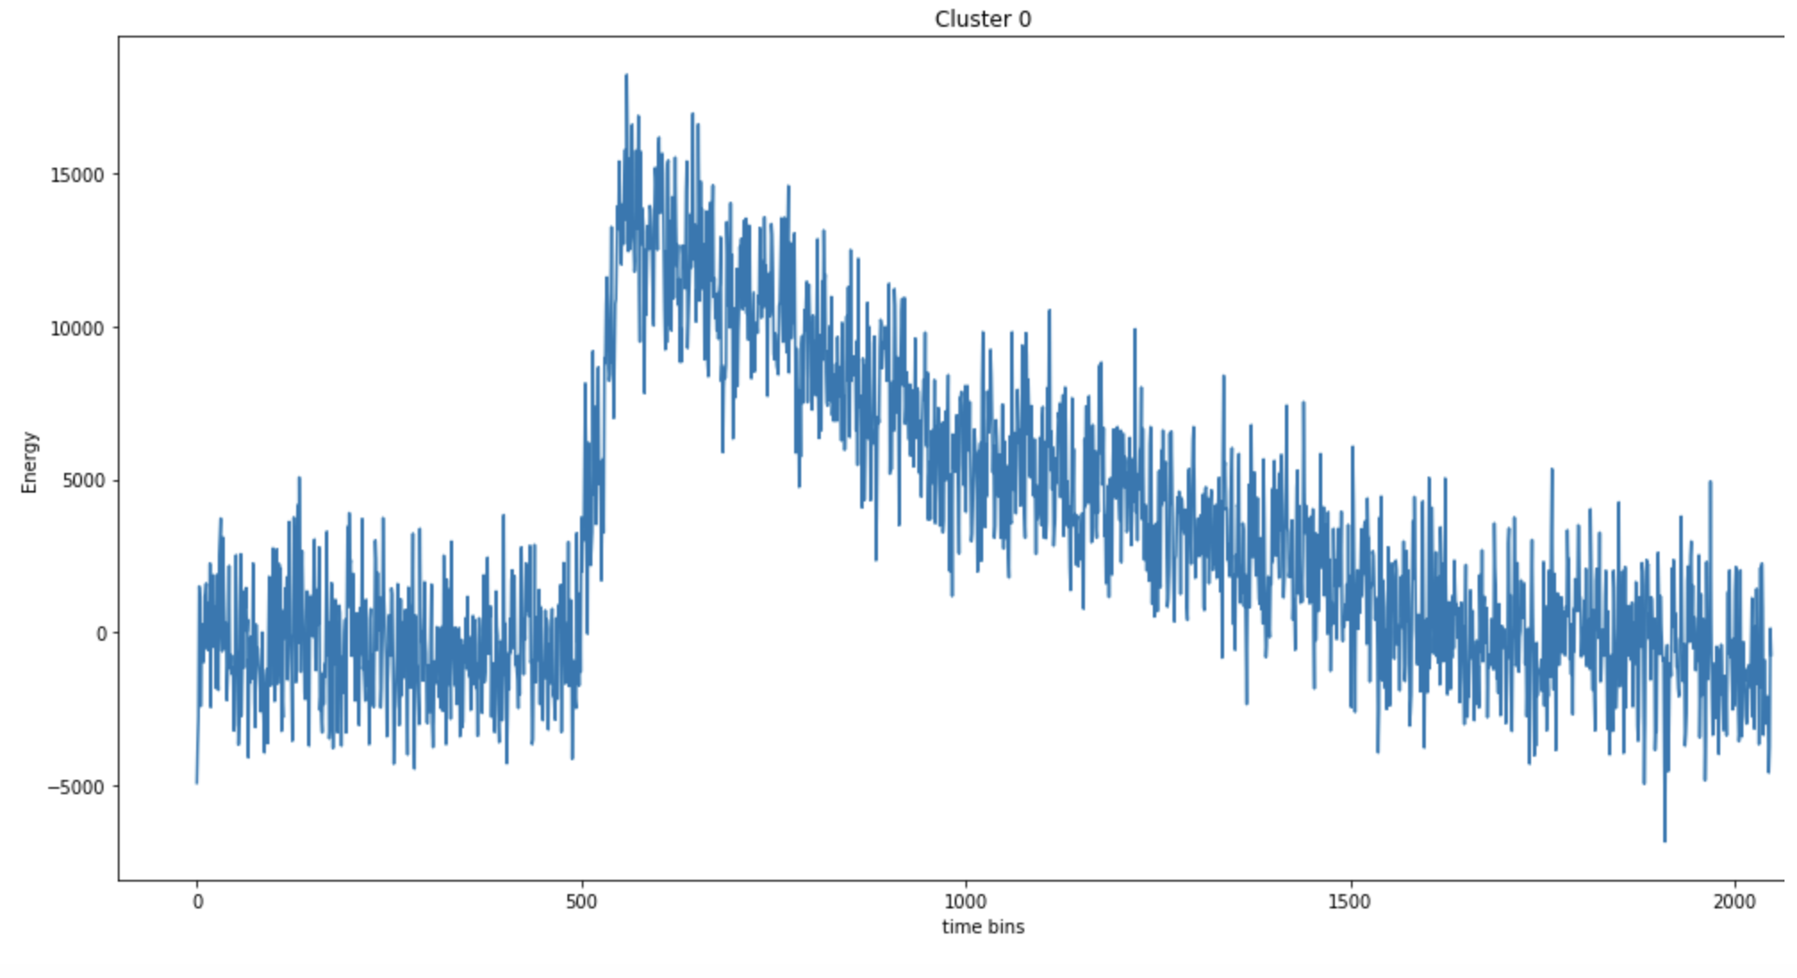
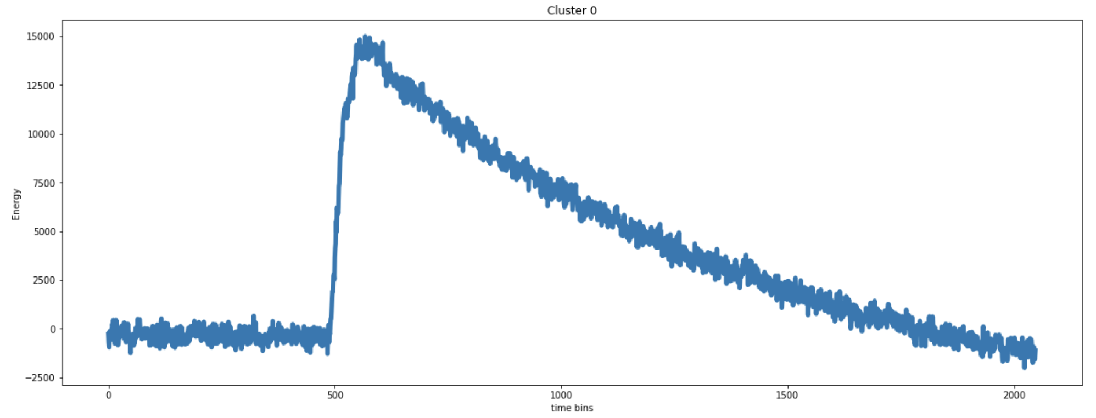
Characteristic Waveforms: Red (Triples)
Triples out of first 500 waveforms
Average

